Slide 2
Introduction to schematics and wiring
Tinkercad | Dashboard
Lets play around with differents curcuits.

Slide 3
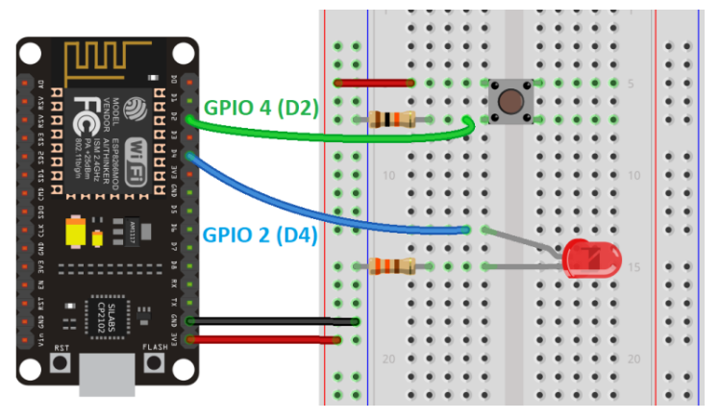
Schematic

